Slide 1
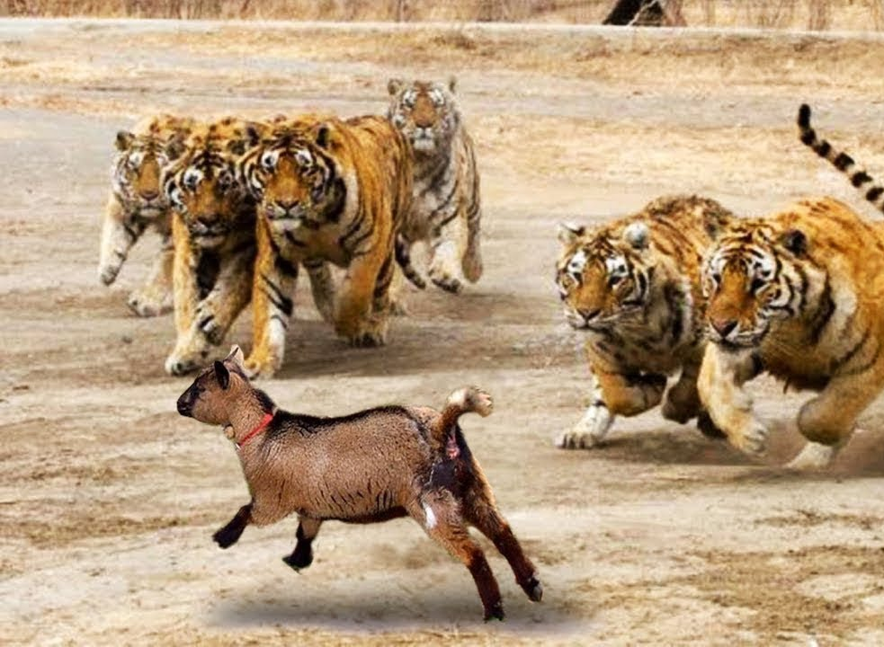
Can the goat ever survive?
Notes:
How can we stop fake news?

Slide 2
Beating BaghChal:
A multi-agent competitive play approach to asymmetric board games
Ankit Shrestha
Utah State University
Logan, Utah, USA
https://colab.research.google.com/drive/1w6jCKoYvh_OBXlM4hZeaddViEa5yDCr0?usp=sharing
Notes:
Good afternoon everyone, I am Ankit Shrestha and today we will address this question of how to stop fake news from the research adapting Security warnings to counter online disinformation by kaiser et al published in USENIX Security 2021.

Slide 3
Contents
Research Questions
Environment and Model
Experiments and Results
Discussion/Implications
Limitations & Future Work
Notes:
This is going to be the overall flow of my presentation today.

Slide 4
Research Questions
1.
RQ1: Can multi agent competitive systems perform better than single agent self play systems in playing asymmetric games?
RQ2: How does data filtering and human play data injection impact the performance of the learning agents?
Notes:
The research questions include do users notice and understand contextual and interstitial warninfs? And do users change their behaviors in the intended way by opting for alternative sources of information after seeing these warnings?

Slide 5
Environment and Model
2.
Notes:
Moving on to methodology of the laboratory study

Slide 6
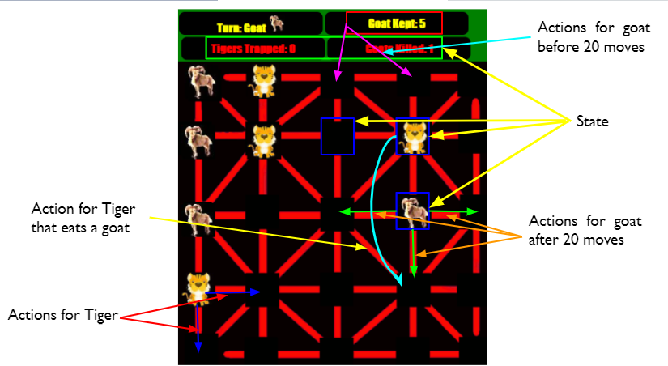
Notes:
Moving on to methodology of the laboratory study

Slide 7
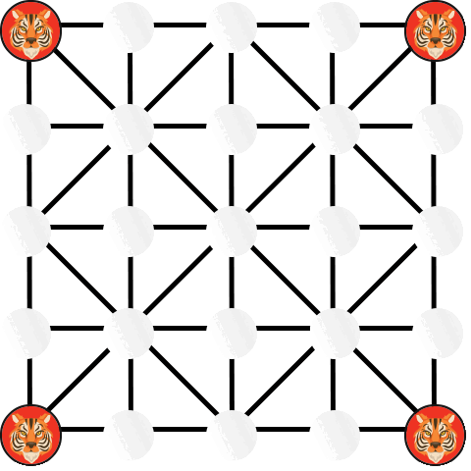
Notes:
Moving on to methodology of the laboratory study

Slide 8
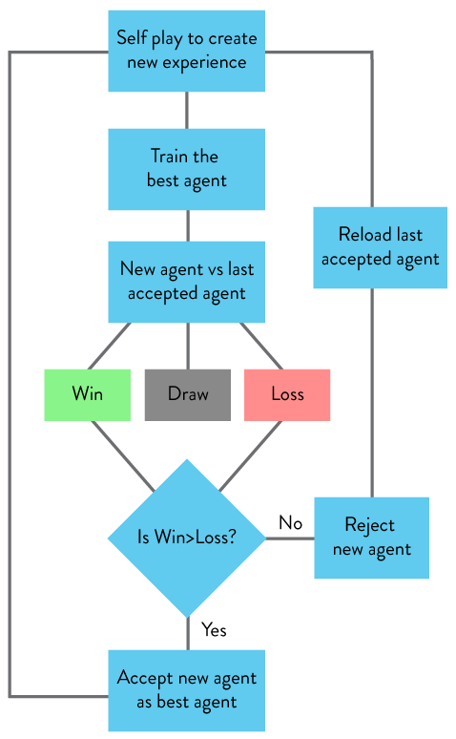
Baseline/Self Play agents
Notes:
The participants for the study

Slide 9
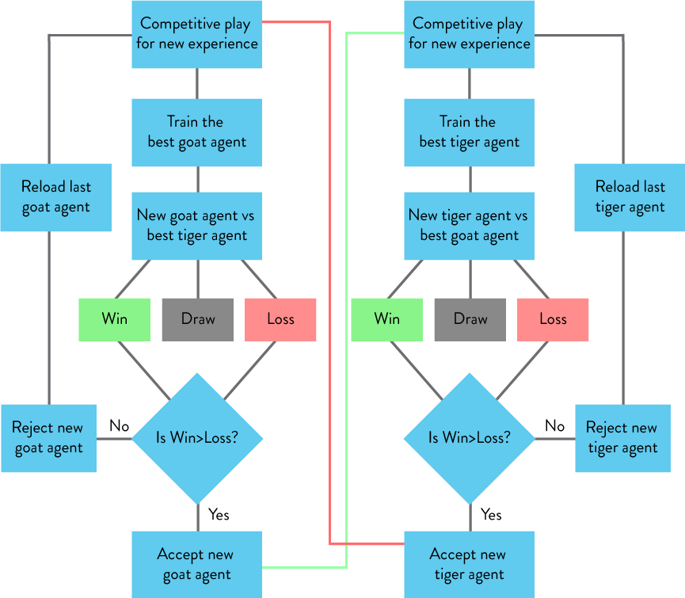
Competitive agents
Notes:
The participants for the study

Slide 10
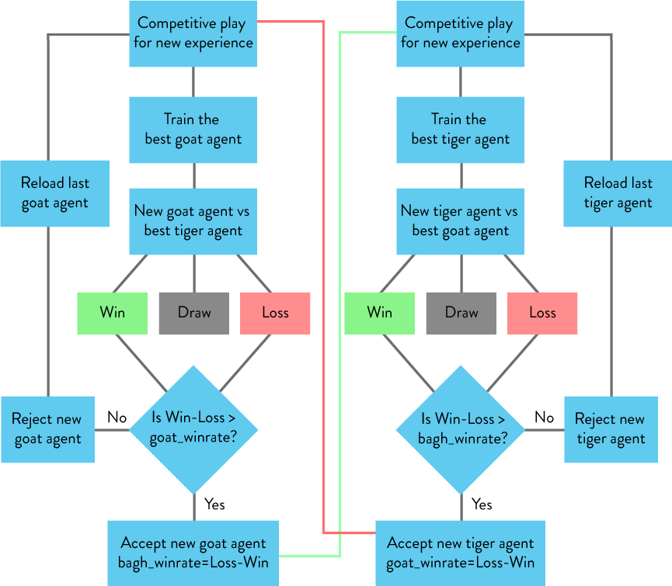
Competitive agents (Acceptance condition changed)
Notes:
The participants for the study

Slide 11
Experiments and Results
3.
Notes:
Moving on to methodology of the laboratory study

Slide 12
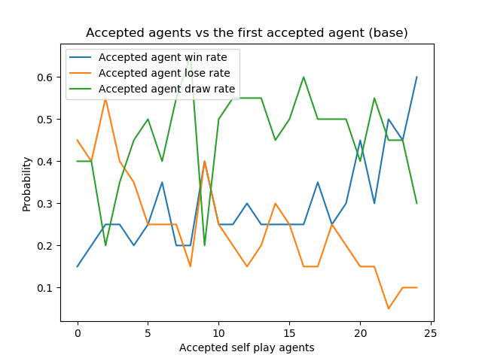
Baseline/Self Play agents
Base agent
Notes:
The participants for the study

Slide 13
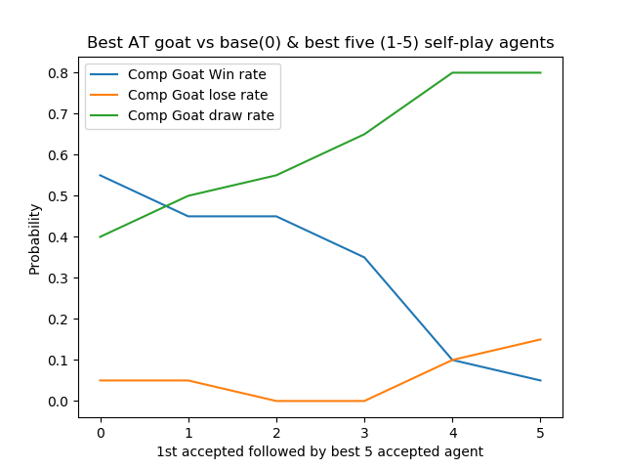
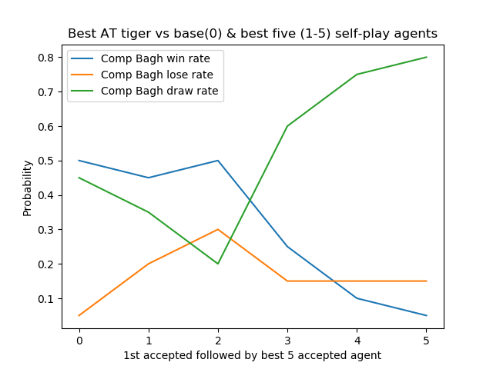
Alternate training
Worst
Best
Comparable but still losing by a little with the best self play agents
Notes:
The participants for the study

Slide 14
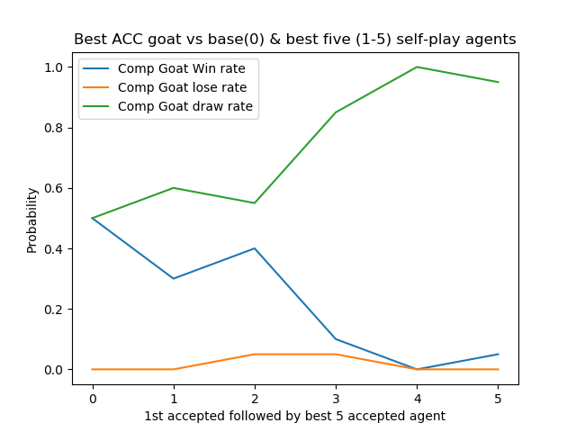
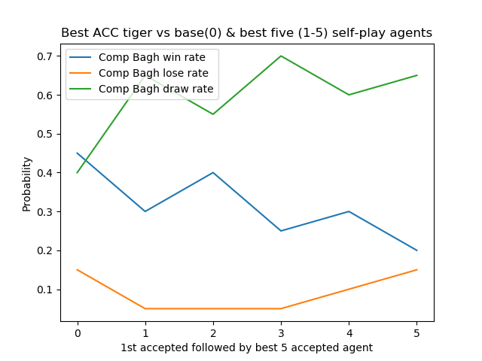
Acceptance Condition Change
Comparable and winning by a little with the best self play agents
Notes:
The participants for the study

Slide 15
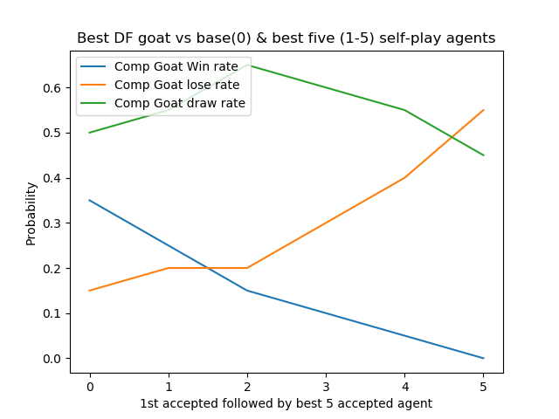
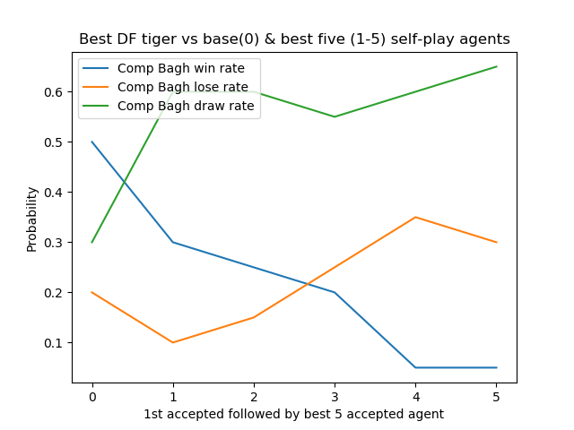
Data Filter
Performance completely decreases against best self play agents
Notes:
The participants for the study

Slide 16
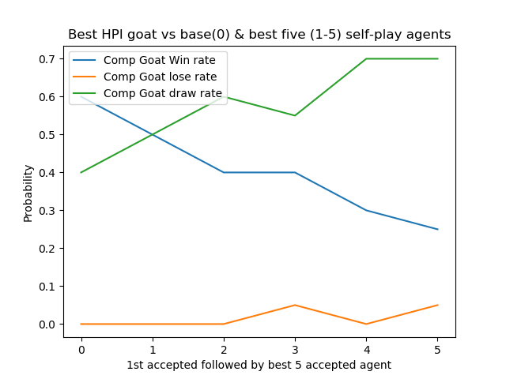
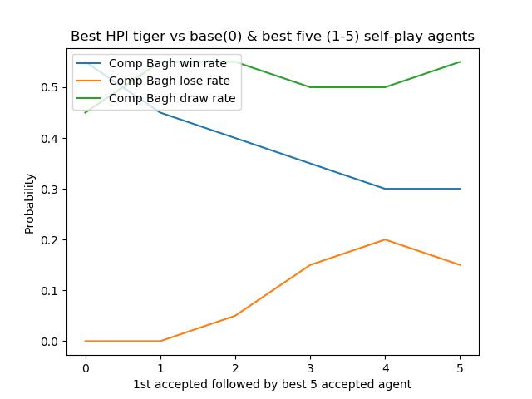
Human Play Injection
Much better performance with consistent wins against the best agents
Notes:
The participants for the study

Slide 17
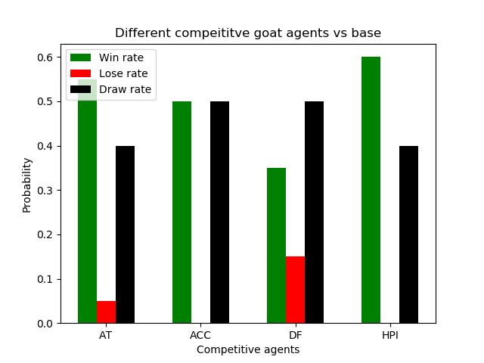
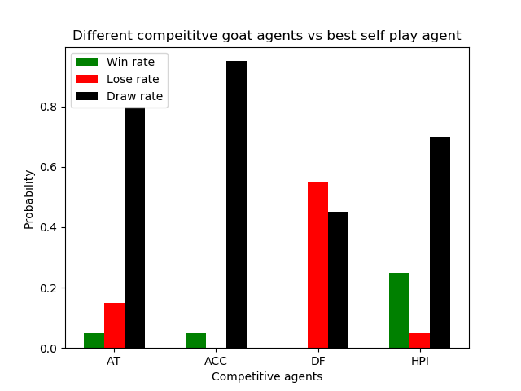
Comparison of competitive goat agents
Notes:
The participants for the study

Slide 18
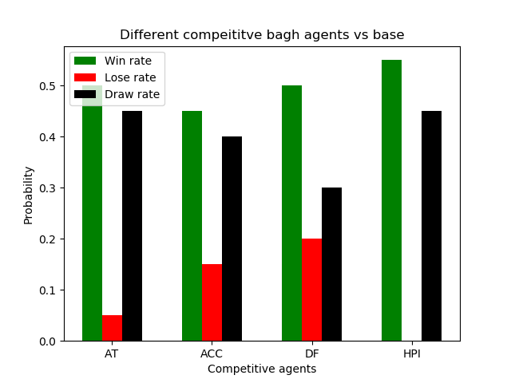
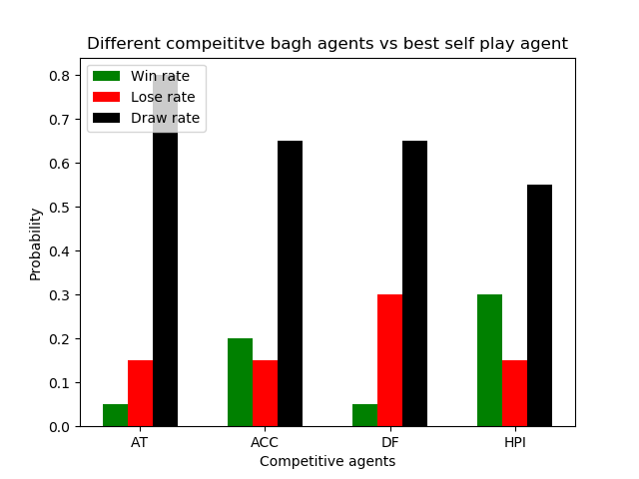
Comparison of competitive tiger agents
Notes:
The participants for the study

Slide 19
Discussions
4.
Notes:
Let us move on to results.

Slide 20
Discussion/Implications
Increased complexity with multiple agents
Need for Human Play Data Injection
Multiple agents to deal with complex systems
Notes:
Let us move to the discussion and implications of these findings.
Majority of the platforms still use contextual warnings but we can clearly see that interstitial warnings are more informative and effective. As security warnings have also moved to interstitial from contextual, it is time to move the disinformation warnings towards interstitial from contextual to improve their effectiveness.
Visual components like icons and colors of the warning can impact the user and they need to be studied and effectively deployed in future warning design
Informativeness and harm performed similar and both are effective strategies to warn the users about the disinformation
Many users mentioned in the first study about the extra work they need to do to pass through interstitial warnings which made them to not click through. However, this is something that is not good as the users are not making an informed decision. This needs to be studied and addressed to improve the disinformation warnings.
Platforms need to research what works best to inform user about disinformation by trying many iterations of interstitial warnings to improve this field as the security warnings have been improved previously

Slide 21
Limitations
& Future Work
5.
Notes:
Now the last section for today, limitations and future work

Slide 22
Limitations
Lack of hyperparameters tuning
Small scale training
Only PPO agents have been used in the project
May not be completely generalizable to more complex problems
Notes:
Some of the limitations of this research are
That the relations
As the demographics are skewed
This research also cannot account for cross cultural behavior and perception of these warnings

Slide 23
Future Work
Improve performance by extensive hyperparameter tuning
Improve validation of results by large scale training
Use different model architecture like A2C, A3C, etc.
Check the validity of the results over more complex domains
Notes:
Future works need to focus on more behavioral research on the effects of these warnings. Future work also should validate and generalize the results from this research by doing a large scale field studies. Even though this was not explored by the authors, i believe, the effect of combination of harm and informativeness in the disinformation warnings can be a very interesting area to do future research on.

Slide 24
Thanks!
Any questions?
Notes:
That is all for this presentation. Thank you and I am ready for the questions now.

